Slide 1

Week: Two(14th, 15th March’08)
☼ Financial Statements
Taxes and Cash Flow
☼ Working
with
Financial Statements

Slide 2
The Statement of Financial Position
Shows a firm’s accounting value on a particular date.
Equation:
Assets = Liabilities + Shareholders’ Equity
Assets are listed in order of liquidity.
Net working capital = Current Assets – Current Liabilities

Slide 3
The Statement of Financial Position
Net
Working Capital
Current Liabilities
Current
Assets
Non-current Liabilities
Fixed Assets
1.Tangible fixed assets
2.Intangible fixed assets
Shareholders’ Equity
Total Value of Liabilities and Shareholders’ Equity
Total Value of Assets

Slide 4
Liquidity
The speed and ease with which an asset can be converted to cash without significant loss of value.
Current assets are liquid (e.g. debtors).
The more liquid a business is, the less likely it is to experience financial distress, but liquid assets are less profitable to hold.

Slide 5
Debt versus Equity
Creditors have first claim on a firm’s cash flow; equity holders have a residual claim.
Financial leverage is the use of debt in a firm’s capital structure.
Financial leverage increases the potential reward to shareholders, but also increases the potential for financial distress and business failure.

Slide 6
Market Value versus Book Value
Generally Accepted Accounting Principles (GAAP) require audited financial statements to show assets at historical cost or book value.
Revaluations of assets to fair value are permitted.
The value of a firm relates to market value, or the price that could be obtained in the current market place.

Slide 7
Example—Market Value versus Book Value
ABC Company has fixed assets with a book value of $1700 but they have been revalued to have a market value of $2000. Net working capital has a book value of $1000, but if all current accounts were liquidated, the company would collect $1400. ABC Company has $1500 in long-term debt—both book value and market value.

Slide 8
Example—Market Value versus Book Value
 | ABC Company
 | Book | Market |  | Book | Market
Assets |  |  | Liabilities
Net working capital | $1000 | $1400 | Long-term debt | $1500 | $1500
Fixed assets | $1700 | $2000 | Equity | $1200 | $1900
Total | $2700 | $3400 | Total | $2700 | $3400

Slide 9
The Statement of Financial Performance
Measures a firm’s performance over a period of time.
Equation:
Profit =Revenues – Expenses
The difference between net profit and cash dividends is called retained earnings, which is added to the retained earnings account in the Statement of Financial Position.

Slide 10
Example—Statement of Financial Performance
Sales $2000
Costs 1400
Depreciation 100
EBIT 500
Interest 100
Taxable Income 400
Tax 200
Net Profit $200
Dividends 80
Addition to R/E $120

Slide 11
Recording of Financial Statement Entries
The realisation principle is to recognise revenue at the time of sale.
Costs are recorded according to the matching principle, that is, revenues are identified and costs associated with these revenues are matched and recorded.

Slide 12
Differences
The figures on the Statement of Financial Performance may differ from actual cash inflows and outflows during a period due to:
  Revenues and costs being recorded when they are realised, not when they are received or paid.
  The existence of non-cash items such as depreciation.

Slide 13
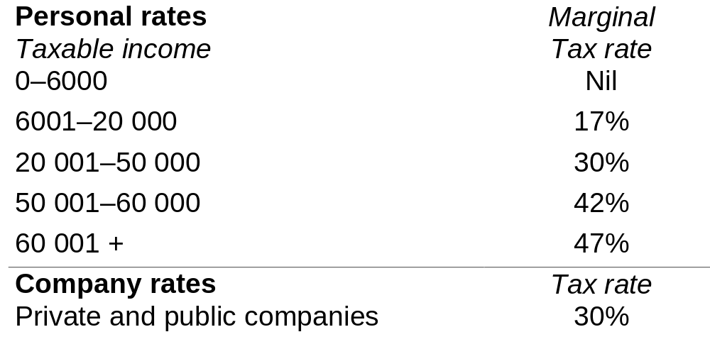
Corporate and Personal Tax Rates

Slide 14
Tax Rates
The average tax rate is the total tax bill divided by taxable income, that is, the percentage of income that goes in taxes.
The marginal tax rate is the extra tax paid if one more dollar is earned.
A flat rate is where there is only one tax rate that is the same for all income levels. An example is the tax rate that applies to companies in Australia.

Slide 15
Example—Tax Rates
An individual has a taxable income of $28 500.
Total tax liability is $4930 (based on the current tax scales).
The average tax rate is 17.30 per cent.
The marginal tax rate is 30 per cent.

Slide 16
Cash Flow from Assets
The total cash flow from assets consists of:
  operating cash flow—the cash flow that results from day-to-day activities of producing and selling; less
  capital spending—the net spending on non-current assets; less
  additions to net working capital (NWC)—the amount spent on net working capital.

Slide 17
Cash Flow from Assets
Cash flow from assets = cash flow to debtholders + cash flow to shareholders
The cash flow to debtholders includes any interest paid less the net new borrowing.
The cash flow to shareholders includes dividends paid out by a firm less net new equity raised.

Slide 18
Cash Flow Summary
  Operating cash flow = Earnings before interest and taxes (EBIT) + Depreciation – Taxes
  Net capital spending = Ending net fixed assets – Beginning net fixed assets + Depreciation
  Change in NWC = Ending NWC – Beginning NWC

Slide 19
Statement of Financial Position ('000s)
Assets (‘000s) | 2003 | 2004
Current assets Cash Accounts receivable Inventory Total Fixed assets Net plant and equipment TOTAL ASSETS | $ 45 260 320 $ 625 985 $1 610 | $ 50 310 385 $ 745 1 100 $1 845

Slide 20
Statement of Financial Position ('000s)
Liabilities and equity (‘000s) | 2003 | 2004
Current liabilities Accounts payable Notes payable Total Long-term debt Shareholders’ equity Ordinary shares Retained earnings Total TOTAL LIABILITIES AND EQUITY | $ 210 110 $ 320 $ 205 290 795 $1 085 $1 610 | $ 260 175 $ 435 $ 225 290 895 $1 185 $1 845

Slide 21
Statement of Financial Performance ('000s)
Net sales $710.00
Cost of goods sold 480.00
Depreciation 30.00
DEBIT $200.00
Interest 20.00
Taxable income 180.00
Tax 53.45
Net profit $126.55
Dividends 26.55
Addition to retained earnings $100.00

Slide 22
Cash Flow From Assets
Operating cash flow:
  EBIT $ 200.00
  + Depreciation + 30.00
  – Taxes – 53.45 $176.55
Change in net working capital:
Ending net working capital $ 310.00
  – Beginning net working capital 305.00 $ 5.00
Net capital spending:
  Ending net fixed assets $ 1,100.00
  – Beginning net fixed assets – 985.00
  + Depreciation + 30.00 $145.00
Cash flow from assets: $ 26.55

Slide 23
Cash Flows to Debtholders and Shareholders
Cash flow to debtholders:
  Interest paid $ 20.00
  – Net new borrowing – 20.00 $ 0.00
Cash flow to shareholders:
  Dividends paid $ 26.55
  – Net new equity raised 0.00 $26.55
Cash flow to debtholders and shareholders $26.55

Slide 24
Working with Financial Statements

Slide 25
Cash
Cash is generated by selling a product or service, asset or security.
Cash is spent by paying for materials and labour to produce a product or service and by purchasing assets.
Recall:
Cash flow from assets = Cash flow to debtholders + Cash flow to shareholders

Slide 26
Cash Flow
Sources of cash are those activities that bring in cash.
Uses of cash are those activities that involve spending cash.
The firm’s statement of cash flows is the firm’s financial statement that summarises its sources and uses of cash over a specified period.

Slide 27
Statement of Financial Position ('000s)
Assets (‘000s) | 2003 | 2004
Current assets Cash Accounts receivable Inventory Total Fixed assets Net plant and equipment TOTAL ASSETS | $ 45 260 320 $ 625 985 $1 610 | $ 50 310 385 $ 745 1 100 $1 845

Slide 28
Statement of Financial Position ('000s)
Liabilities and equity (‘000s) | 2003 | 2004
Current liabilities Accounts payable Notes payable Total Long-term debt Shareholders’ equity Ordinary shares Retained earnings Total TOTAL LIABILITIES AND EQUITY | $ 210 110 $ 320 $ 205 290 795 $1 085 $1 610 | $ 260 175 $ 435 $ 225 290 895 $1 185 $1 845

Slide 29
Statement of Financial Performance ('000s)
Net sales $710.00
Cost of goods sold 480.00
Depreciation 30.00
EBIT $200.00
Interest 20.00
Taxable income 180.00
Tax 53.45
Net profit $126.55
Dividends 26.55
Addition to retained earnings $100.00

Slide 30
Statement of Cash Flows
A statement that summarises the sources and uses of cash.
Changes are divided into three main categories:
  Operating activities—includes net profit and changes in most current accounts
  Investment activities—includes changes in fixed assets
  Financing activities—includes changes in notes payable, long-term debt and equity accounts as well as dividends.

Slide 31
Statement of Cash Flows
Operating activities
  + Net profit
  + Depreciation
  + Any decrease in current assets (except cash)
  + Increase in accounts payable
  – Any increase in current assets (except cash)
  – Decrease in accounts payable
Investment activities
  + Ending fixed assets
  – Beginning fixed assets
  + Depreciation

Slide 32
Statement of Cash Flows
Financing activities
  – Decrease in notes payable
  + Increase in notes payable
  – Decrease in long-term debt
  + Increase in long-term debt
  + Increase in ordinary shares
  – Dividends paid

Slide 33
Statement of Cash Flows
Operating activities
  + Net profit + $ 126.55
  + Depreciation + 30.00
  + Increase in payables + 50.00
  – Increase in receivables – 50.00
  – Increase in inventory – 65.00
  $ 91.55
Investment activities
  + Ending fixed assets +$1 100.00
  – Beginning fixed assets – 985.00
  + Depreciation + 30.00
  ( $ 145.00)

Slide 34
Statement of Cash Flows
Financing activities
  + Increase in notes payable + $ 65.00
  + Increase in long-term debt + 20.00
  – Dividends – 26.55
  $ 58.45
Putting it all together, the net addition to cash for the period is:
$91.55 – 145.00 + 58.45 = $5.00

Slide 35
‘Players’ in Accounting Standards
Accountants
Government
Regulators
Other users

Slide 36
Ratio Analysis
Financial ratios are relationships determined from a firm’s financial information.
Used to compare and investigate relationships between different pieces of financial information, either over time or between companies.
Ratios eliminate the size problem.

Slide 37
Categories of Financial Ratios
Liquidity—measures the firm’s short-term solvency.
Capital structure—measures the firm’s ability to meet long-run obligations (financial leverage).
Asset management (turnover)—measures the efficiency of asset usage to generate sales.
Profitability—measures the firm’s ability to control expenses.
Market value—per-share ratios.

Slide 38
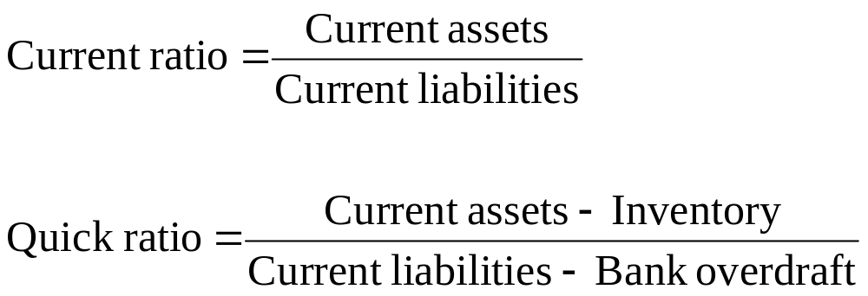
Liquidity Ratios

Slide 39
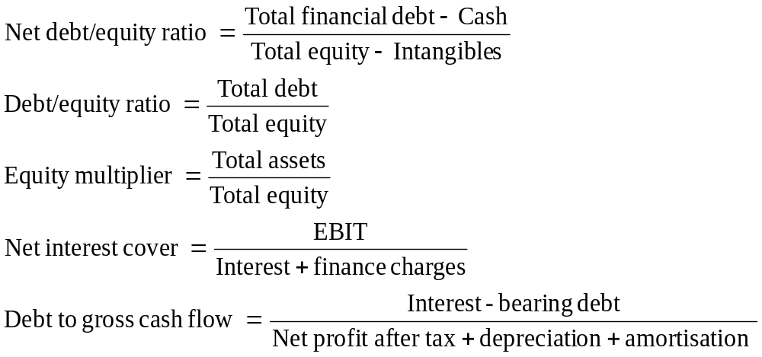
Capital Structure Ratios

Slide 40
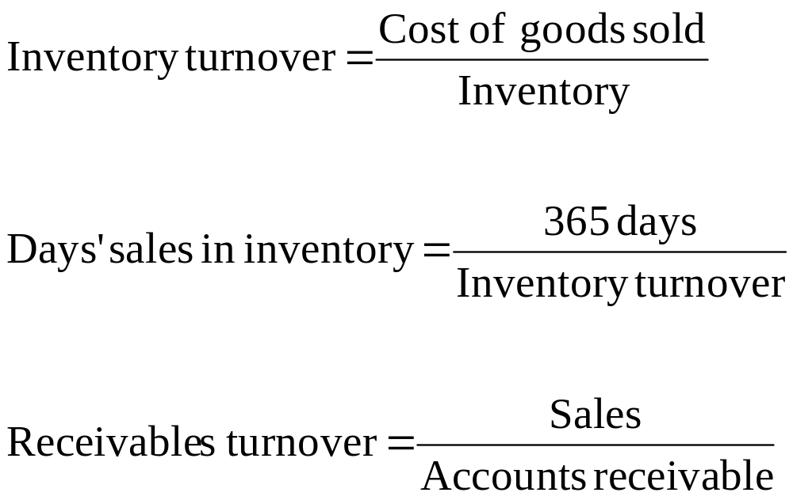
Turnover Ratios

Slide 41
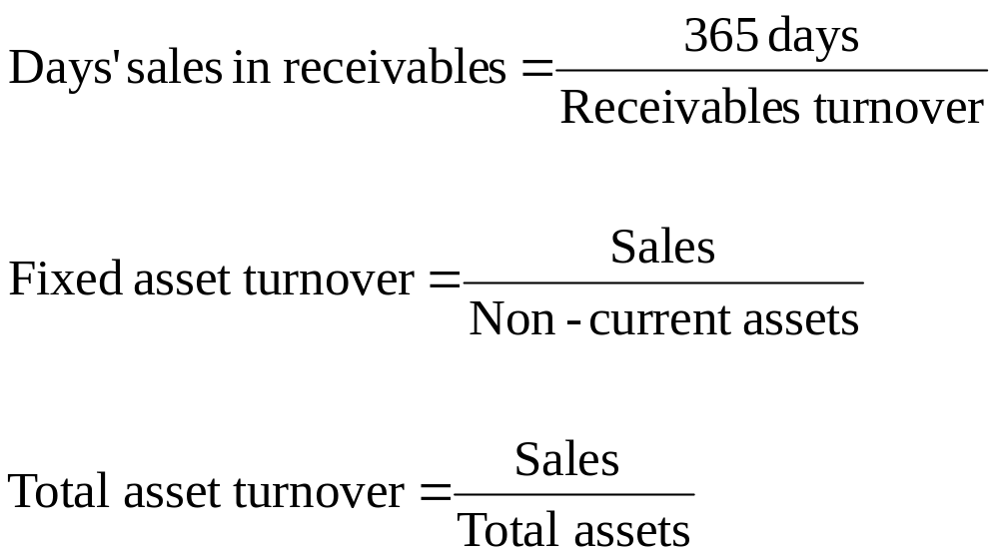
Turnover Ratios (continued)

Slide 42
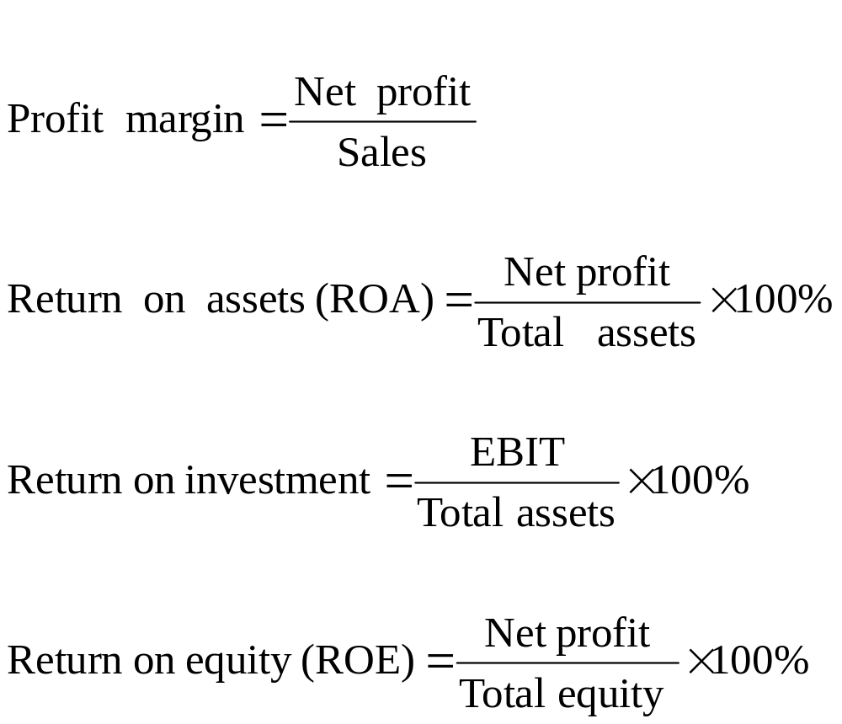
Profitability Ratios

Slide 43
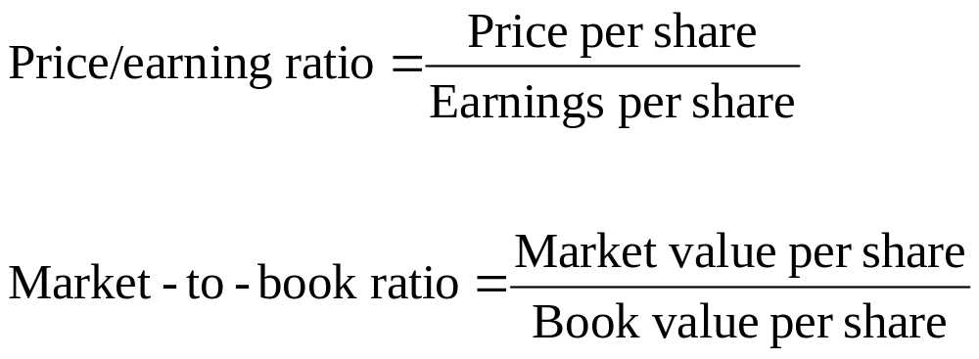
Market Value Ratios

Slide 44
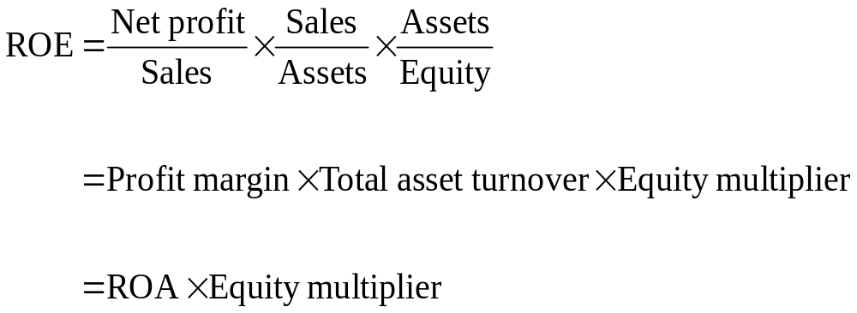
The Du Pont Identity
Breaks ROE into three parts:
  operating efficiency
  asset use efficiency
  financial leverage

Slide 45
Uses for Financial Statement Information
Internal uses:
  performance evaluation
  planning for the future
External uses:
  evaluation by outside parties
  evaluation of main competitors
  identifying potential takeover targets

Slide 46
Benchmarks for Comparison
Ratios are most useful when compared to a benchmark.
Time-trend analysis—examine how a particular ratio(s) has performed historically.
Peer group analysis—using similar firms (competitors) for comparison of results.
Global Industry Classification Standard (GICS) used by ASX is a useful way to find a peer company.

Slide 47
Problems with Ratio Analysis
No underlying theory to identify correct ratios to use or appropriate benchmarks.
Benchmarking is difficult for diversified firms.
Firms may use different accounting procedures.
Firms may have different recording periods.
One-off events can severely affect financial performance.

